Slide 1

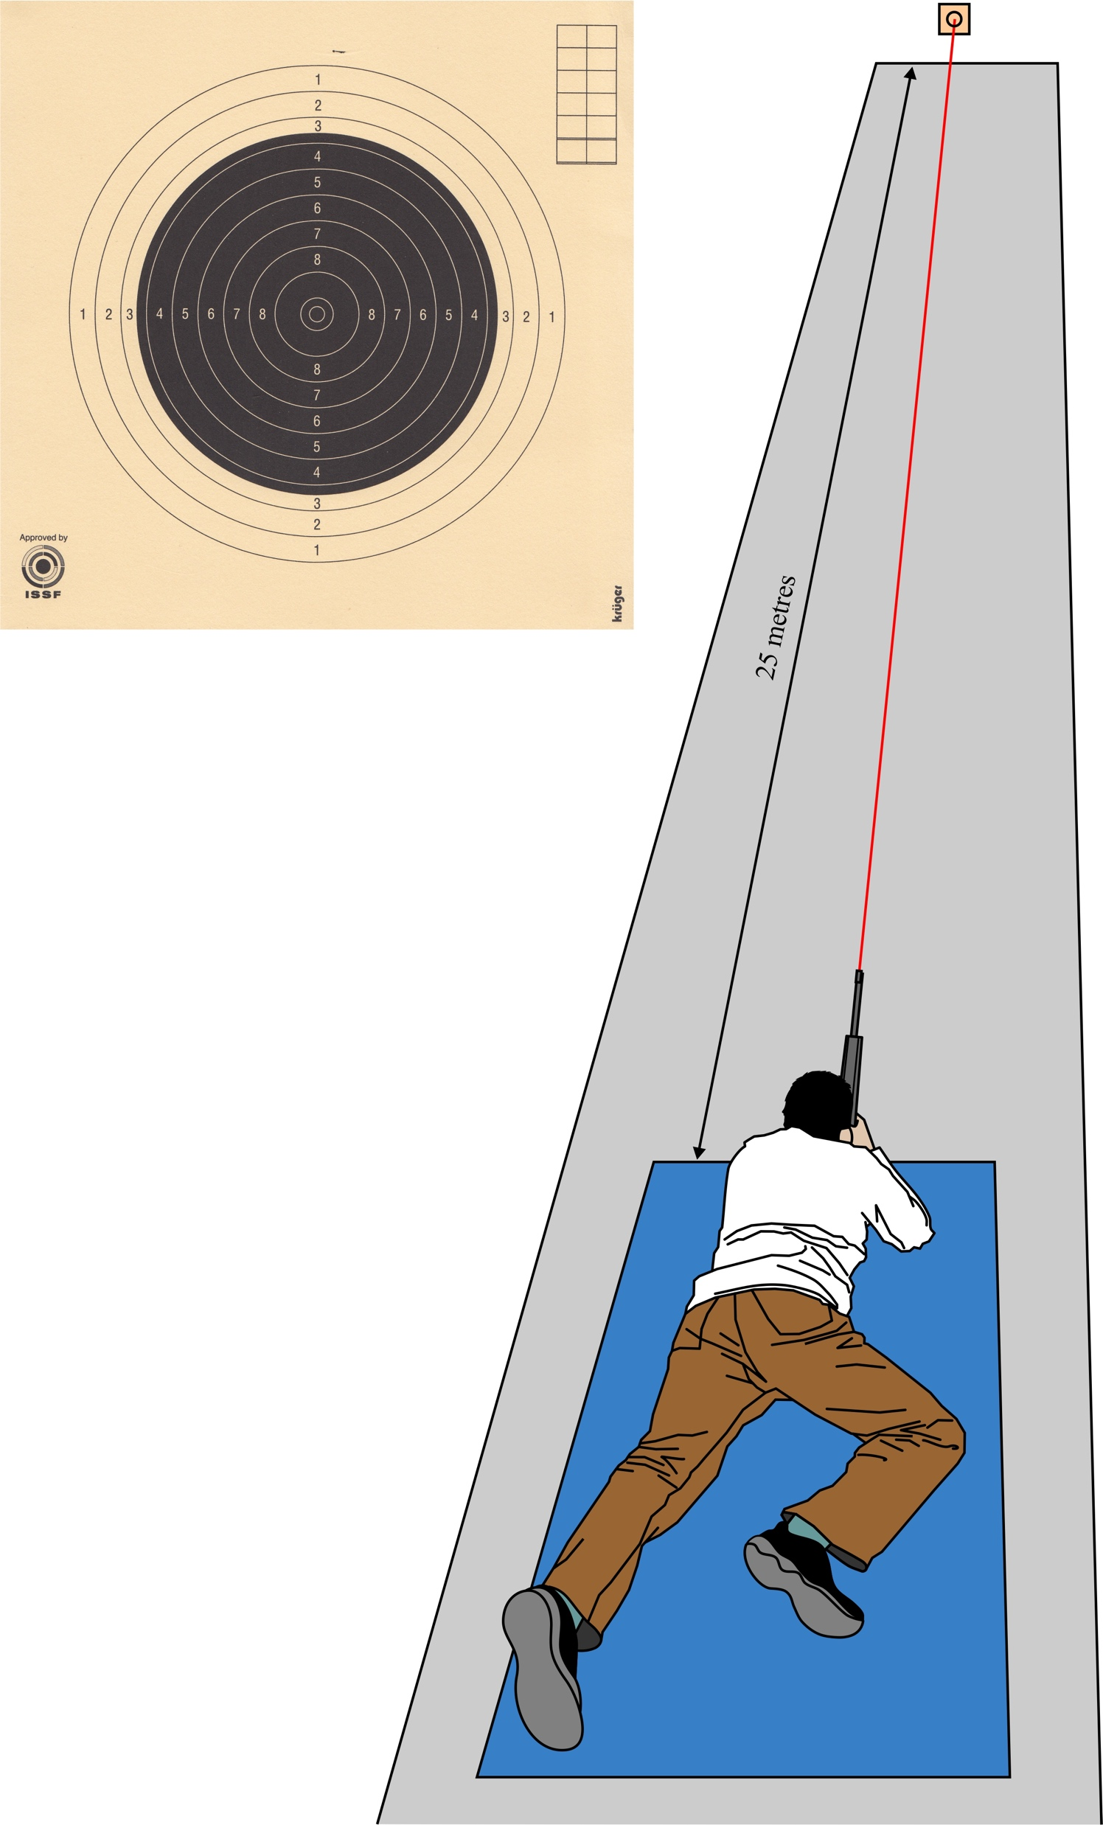
Does accuracy improve when shooting a rifle at 25m using EasyHit compared to a standard sight? Ramsay, E., Arnold, G. P., Wang, W., Nasir, S., Drew, T. S., Abboud. R. J,
Institute of Motion Analysis and Research, Department of Orthopaedic and Trauma Surgery, Tayside Orthopaedic Rehabilitation and Technology Centre, Ninewells Hospital, Dundee, UK
Introduction
Methods and Materials
Results
Discussion and Conclusions
At least 1.6 million people shoot regularly in the UK¹ – ranging from complete beginners to a successful Olympic team.
The literature surrounding rifle shooting is sparse compared to other sports such as rugby and football. Two studies were found comparing binocular and monocular vision in a ‘point and shoot’ sport. In archery, monocular vision increased the accuracy of the shot in terms of score².
Twenty-four healthy participants without any uncorrected visual problems were recruited for the study, the vast majority of whom were novice shooters. They were asked to shoot with an iron sight, to show monocular vision, and an EasyHit sight to simulate binocular vision.
Further to this the targets from each participant were analysed in terms of both score and grouping (how close the bullets are to one another).
This study has been approved by the University of Dundee Medical School Ethics Committee.
The materials used are listed below:
.22 Ruger small bore rifle
Kruger Druck Plus VE target
Iron sight and EasyHit sight
ESE lightweight prone shooting mat
iPhone 6s with iTarget application loaded on
Sightmark .22lr Boresight laser bullet
Further to reading a participant information sheet 24hrs prior to the study, each participant signed a consent form. A Kruger Druck Plus VE target was set up 25m from the nearest part of shooting mat. The iPhone 6s was set up 0.5m away from the target with the iTarget application running.
The volunteers were tested for eye dominance before being asked to lie in prone position on the mat as shown below.
The mean score for iron sights was greater than when using the EasyHit sight with a mean score of 47.6 compared to 41.9 respectively. This difference was found to be statistically significant (p = 0.015).
The general trend for grouping found that the iron sight had a smaller grouping than the EasyHit in terms of smallest distance, largest distance and average distance between shots. This however was not statistically significant.
Overall monocular shooting was more accurate in terms of both score and grouping than binocular vision.
The most likely reasons for score are listed below:
Physiological double vision and interocular rivalry and suppression - does not occur in monocular vision⁴
Participants either saw two targets or two sights when using binocular vision
Difficulty in focusing using binocular vision
Decreased quiet eye duration during binocular shooting due to stress/anxiety – many participants found binocular shooting ‘difficult’ and ‘unnatural’^{5,6,7}
Due to difficulty and stress/anxiety, the volunteers may have focused longer on the target, so were affected by the afterimage phenomenon⁸
The most likely reason for poor grouping across both sights is because novices were used, who generally have a large group (bullets are far away from one another). Other reasons may have included:
Decreased stability of rifle due to upper body fatigue caused by the ’heavy’ weight of the rifle⁹
A temporary tremor developed due to this fatigue
Poor posture and large body sway comparatively to elite shooter
Mean score ± standard deviation for both sights
Participants were asked to shoot a total of thirty shots with each sight, using the .22 rifle loaded with the laser bullet. These were recorded by the iTarget system.
Half the cohort shot with the EasyHit sight first and the other with the iron sight first. This was to stop bias in the data resulting from increasing familiarity with the rifle and equipment.
Aims and Objectives
The aim of this project is to establish whether or not there is a difference in accuracy between shooting with one eye closed and with both eyes open. Monocular vision was tested using an iron sight and binocular vision with an EasyHit sight.
They were measured in terms of score and grouping. It was carried out using an iTarget application on a smartphone and a custom-made programme on Python before analysing using Microsoft Excel and SPSS.
Acknowledgement & References
Thank you to Professor Abboud for his continuous guidance throughout the project as well as all the staff at IMAR who gave so much help and time.
¹ BASC (2018) Shooting - the facts for journalists, Future Plc.
² Strydom, B. and Ferreira, J. (2010) ‘The role of vision and visual skills in archery’, The South African Optometrist, 69, pp. 121–28
³ Christie, I. S. (2019) ‘Sports lab plan view [custom image] ©’. Department of Orthopaedic and Trauma Surgery, University of Dundee
⁴ Tong, F. and Engel, S. A. (2001) ‘Interocular rivalry revealed in the human cortical blind-spot representation’, Nature, 411, pp. 195–199
⁵ Vickers, J. N., Roderigues, S. T. and Edworthy, G. (2000) ‘Quiet eye and accuracy in the dart throw’, International Journal of Sports Vision, 6(1), pp. 30–36
⁶ Behan, M. and Wilson, M. (2008) ‘State anxiety and visual attention: The role of the quiet eye period in aiming at a far target’, Journal of Sports Sciences, 26(2), pp. 207–215
⁷ Causer, J. et al. (2010) ‘Quiet eye duration and gun motion in elite shotgun shooting’, Medicine and Science in Sports and Exercise, 42(8), pp. 1599–1608
⁸ Mack, A. and Bachant, J. (1969) ‘Perceived movement of the afterimage during eye movements’, Perception & Psychophysics, 6(6), pp. 379–384
⁹ Grebot, C., Groslambert, A. and Rouillon, J. (2002) ‘Relationship between velocity and accuracy in standing shooting in biathlon.’, Science & Sports, 17(1), pp. 35–37
Set-up of lab with participant shooting³
Mean ± 1 standard deviation for groupings with iron sight and EasyHit sight

